Slide 1

What’s New In MVC 2?
Joe Wilson, President
Volare Systems, Inc.
Web: http://VolareSystems.com
Blog: http://VolareSystems.com/Blog
Twitter: joe_in_denver

Slide 2
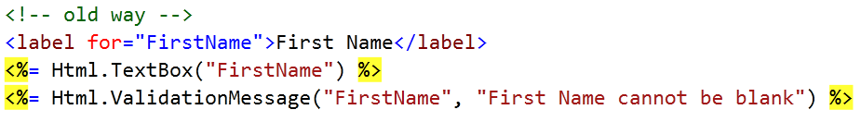
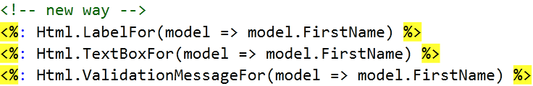
Improved Html Helpers

Slide 3
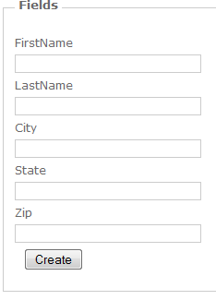
New Templates

Slide 4
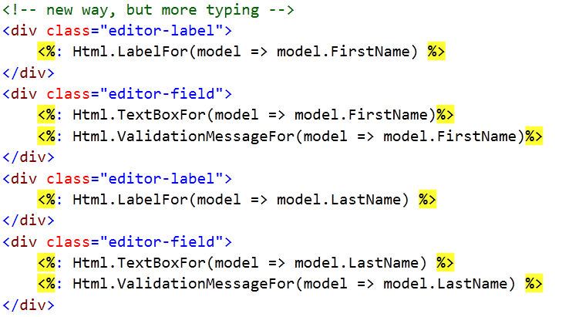

New Templates – EditorForModel()

Slide 5
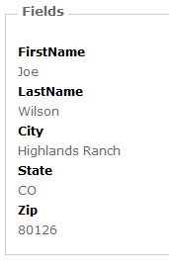
New Templates – DisplayForModel()

Slide 6
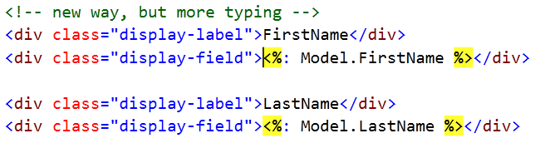

New Templates – DisplayForModel()

Slide 7
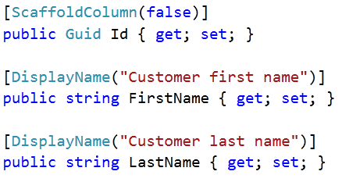
New Templates – Customize

Slide 8
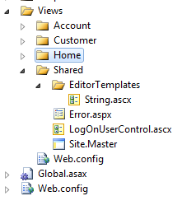
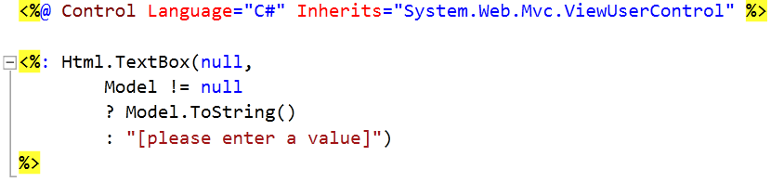
New Templates – Customize

Slide 9
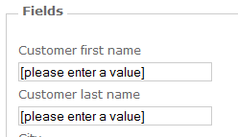
New Templates – Customize

Slide 10
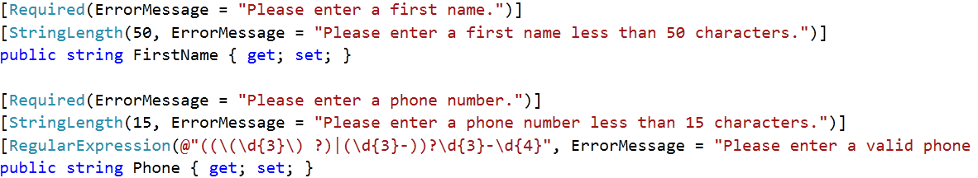
Improved Validation

Slide 11
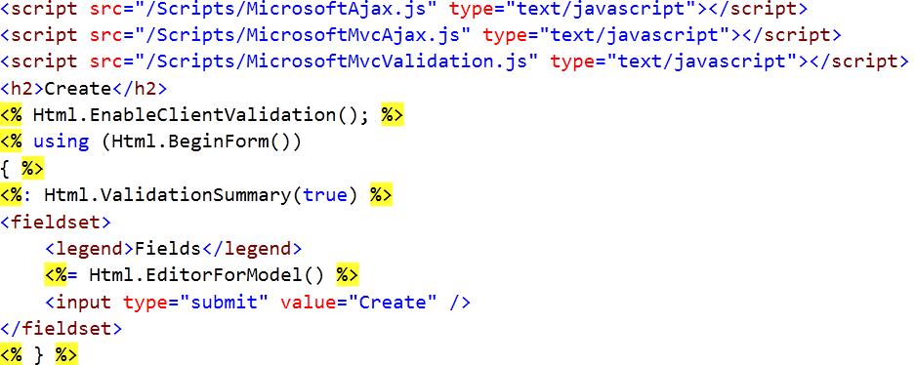
Improved Validation

Slide 12
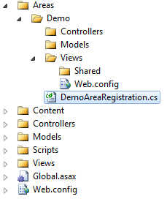
New Areas

Slide 13
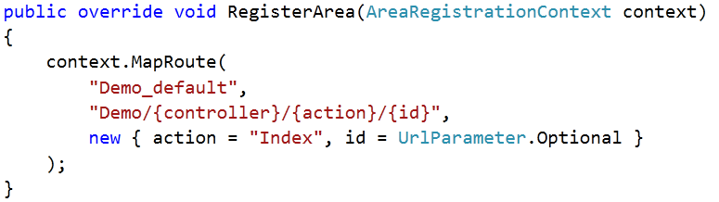
New Areas

